Slide 1
Lecture 6 - Distributed Component frameworks

Slide 2
What is a component?
Very intuitive, but often vaguely defined
A semiconductor chip is a component
The chip vendor publishes manuals that tell developers the functionality of each pin
A0-A16 I/O Address bus
D0-D8 I/O Data bus
ACK O Acknowledge: Accepted when low

Slide 3
Building complex systems
Hardware system integrators connect pins of chips together according to their functions to build complex electronic devices such as computers.
Pins functionality defines behavior of the chip.
Pins functionality is standardized to match functionality of the board (and take advantage of common services).
Component
one
Component
two

Slide 4
Software components
The software component model takes a very similar approach:
  the “pins” of software components are called interfaces
  an interface is a set of methods that the component implements
  software integrators connects components according to the descriptions of the methods within the interface.
Component
one
Component
two
component’s interface
methods

Slide 5
Software components (2)
Component technology is still young, and there isn’t even agreement on the definition of its most important element - the component.
“a component is a software module that publishes or registers its interfaces”, a definition by P. Harmon, Component Development Strategy newsletter (1998).
Note: a component does not have to be an object!
An object can be implemented in any language as long as all the methods of its interface are implemented.
Objects – Design level
Components – Architectural level

Slide 6
Component wiring
The traditional programming model is caller-driven (application calls methods of a component’s interface, information is pulled from the callee as needed). Component never calls back.
In the component programming model, connecting components may call each other (connection-oriented programming).
The components can interacts with each other through event notification (a component pushes information to another component as some event arises). This enables wiring components at runtime.
Component
one
Component
two

Slide 7
Pragmatic definition
Software Components:
  predictable behavior: implement a common interface
  embedded in a framework that provides common services (events, persistence, security, transactions,…)
  developer implements only business logic

Slide 8
Distributed Component Models
Hide implementation details
Remove vendor dependencies
Bring power of a container
Focus on business logic
Enable development of third-party interoperable components

Slide 9
Examples of component frameworks
CORBA (Component Object Request Broker Architecture)
Java/J2EE - EJB (Enterprise Java Beans), Spring Beans
Microsoft/.NET – DCOM, WCF Services

Slide 10
CORBA
CORBA is the acronym for Common Object Request Broker Architecture
CORBA grew out of academic efforts to build a distributed computing framework around RPC
  Dubbed ‘middleware’ since it aims to transparently connect systems running on different platforms
CORBA specification administered by the Object Management Group (OMG)
  Now up to CORBA 3
Implementations of the CORBA spec are referred to as Object Request Brokers (ORBs)
  An ORB is built for a particular language (e.g. C++, Java)

Slide 11
CORBA Code Generation
IDL file
(.idl)
IDL
Compiler
Client source
(.cpp, .java, etc)
Stub source
(.cpp, .java, etc)
Skeleton source
(.cpp, .java, etc)
Server source
(.cpp, .java, etc)
C++/Java
Compiler
RPC Library
C++/Java
Compiler
Client program
(.exe)
Server program
(.exe)

Slide 12
CORBA and O-O
Object-orientation gave the opportunity to hide the internal details of RPC such as marshaling
  Interfaces are implemented as C++/Java/etc objects that inherit from an IDL-generated C++/Java/etc class
    Uses polymorphism to direct incoming call to your object
An object that implements an interface is roughly equivalent to the concept of a component
    CORBA never really mentioned ‘component’ until the CORBA Component Model (CCM) that added things like support for authentication, persistence and transactions

Slide 13
CORBA Interoperability
ORB’s use IIOP to communicate with each other.
Using the standard protocol IIOP, a CORBA-based program from any vendor, on almost any computer, operating system, programming language, and network, can interoperate with a CORBA-based program from the same or another vendor, on almost any other computer, operating system, programming language, and network.
  IIOP (Internet Inter-ORB Operability Protocol); Defines:
    Message types and binary message format
    Data format - Binary format for data types (e.g. int, double, string)
    Object reference format - identifies the object and its host server

Slide 14

CORBA Interoperability
Client
Server
stub
skeleton
ORB 1
ORB 2
IIOP

Slide 15
CORBA Naming Service
CORBA Naming Service allows you to associate abstract names with CORBA objects and allows clients to find those objects by looking up the corresponding name.
A naming service is a central server that knows where other servers can be found, like an index
  Allows locating an object based on a user-friendly name, avoiding the need to hard-code object-server allocations
  Means that the server machine, an object is hosted on, can be changed without breaking the distributed application

Slide 16
CORBA Naming Service
CORBA Server application
4. Invoke methods on objects
Namespace
<name_1, objref_1>
<name_2, objref_2>
<name_3, objref_3>
<name_n, objref_n>
1. bind( name, objref)
3. Resolve returns an object reference
CORBA Client
2. resolve(name)

Slide 17
IDL Example: CORBA IDL
module Utilities
{
// Basic example interface
interface Calculator
{
int Add(in int operand1, in int operand2);
double Add(in double operand1, in double operand2);
}
// Interface inheritance
interface ScientificCalculator : Calculator
{
// Returning values by the parameter list
void SolveQuadratic(in float a, in float b, in float c, out float x1,
out float x2);
// Example with a string
double EvaluateExpression(in string expr);
}
}

Slide 18
CORBA Example (Java) - Server
public class CalculatorImpl
extends CalculatorImplBase ← xyzImplBase is generated by IDL compiler
{
public CalculatorImpl() {
super(); ← Let xyzImplBase do important initialisation work
}
public int Add(int operand1, int operand2) { ← Actual interface function
return operand1 + operand2;
}
}
------------------------------------------------------------------------------------------
import org.omg.*;
public class CalcServer {
public static void main(String[] args) {
CORBA.ORB orb = CORBA.ORB.init(args, null); ← Initialise Java’s ORB
CalculatorImpl calc;
calc = new CalculatorImpl();
orb.connect(calc); ← Tell ORB about Calculator object
sObjRef = orb.object_to_string(calc);
System.out.println("Object ref: " + sObjRef); ← Print stringified obj ref for use by clients
System.out.println("Press Enter to exit"); (using a name server is better, but more complex)
System.in.readln(); ← Wait for client requests
}
}

Slide 19
CORBA Example (Java) - Client
import org.omg.*;
public class CalcClient
{
public static void Main(String[] args) {
CORBA.ORB orb = CORBA.ORB.init(args, null); ← Initialise Java’s ORB
String sServerRef = args[0]; ← Assume user has reference for server
(better to use name server, but more complex)
CORBA.Object temp = orb.string_to_object(sServerRef); ← Create Calculator on remote server, return ref
Calculator calc = CalculatorHelper.narrow(temp); ← Narrow (downcast)
Object to Calculator
System.out.println("1 + 2 = " + calc.Add(1, 2));
}
}

Slide 20
CORBA Notes
Each vendor will have slightly different ways of declaring and creating CORBA objects
  The basic organisation of the code will be similar, just the specifics of ORB initialisation and where to get classes
Note that a CORBA server object is first created by the server host process, then registered with the ORB
  Means that the server object is always running awaiting new incoming client connections
  Registration (via orb.connect) must only happen once for each object

Slide 21
CORBA Today
Although conceptually quite elegant, CORBA never really caught on, for a couple of reasons:
  The CORBA spec is huge, making it complex to use
  Competing frameworks were developed around the same time that had better backing and/or a broader coder base
    Although CORBA was not widely adopted, some concepts that
    it focused on such as interoperability and common standards
    were relevant for Web Services as well.

Slide 22
Enterprise Java Beans

Slide 23
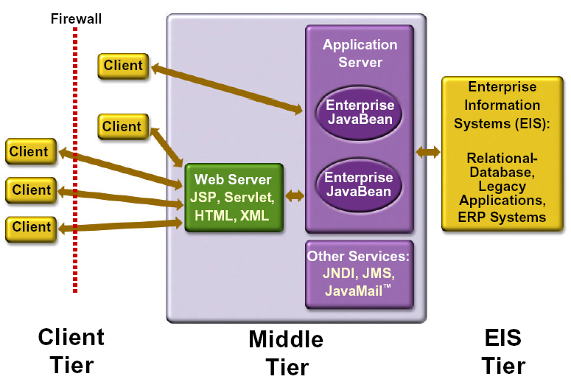
J2EE Architecture
Three-tiered applications that run in this way extend the standard two-tiered client and server model by placing a multithreaded application server between the client application and back-end storage

Slide 24
J2EE Containers
The application server maintains control and provides services through an interface or framework known as a container
Server-side containers:
  The server itself, which provides the J2EE runtime environment and the other two containers
  An EJB container to manage EJB components
  A Web container to manage servlets and JSP pages

Slide 25
J2EE Components
As said earlier, J2EE applications are made up of components
A J2EE component is a self-contained functional software unit that is assembled into a J2EE application with its related classes and files and that communicates with other components
Client components run on the client machine, which correlate to the client containers
Web components -servlets and JSP pages
EJB Components

Slide 26
Packaging Applications and Components
Under J2EE, applications and components reside in Java Archive (JAR) files
These JARs are named with different extensions to denote their purpose, and the terminology is important

Slide 27
Various File types
Enterprise Archive (EAR) files represent the application, and contain all other server-side component archives that comprise the application
Client interface files and EJB components reside in JAR files
Web components reside in Web Archive (WAR) files

Slide 28
Deployment Descriptors
Used prior to EJB 3.0 to deploy and specify the behavior
of EJBs
Deployment descriptors are included in the JARs, along with component-related resources
Deployment descriptors are XML documents that describe configuration and other deployment settings (remember that the J2EE application server controls many functional aspects of the services it provides)
The statements in the deployment descriptor are declarative instructions to the J2EE container; for example, transactional settings are defined in the deployment descriptor and implemented by the J2EE container

Slide 29
Deployment Descriptors
Most J2EE Web Services vendors provide a GUI tool for generating deployment descriptors and performing deployment because creating manual entries is tedious and error prone
The deployment descriptor for an EJB component must be named ejb-jar.xml, and it resides in the META-INF directory inside the EJB JAR file

Slide 30
EJB Components
EJB components are server-side, modular, and reusable, comprising specific units of functionality
They are similar to the Java classes we create every day, but are subject to special restrictions and must provide specific interfaces for container and client use and access
We should consider using EJB components for applications that require scalability, transactional processing, or availability to multiple client types

Slide 31
EJB Components- Major Types
Session beans (verbs of a system)
  These may be either stateful or stateless and are primarily used to encapsulate business logic, carry out tasks on behalf of a client, and act as controllers or managers for other beans
Entity beans (nouns of a system)
  Entity beans represent persistent objects or business concepts that exist beyond a specific application's lifetime; they are typically stored in a relational database
Message Driven Beans:
  Asynchronous communication with MOM
  Conduit for non-J2EE resources to access Session and Entity Beans via JCA Resource adapters

Slide 32
EJB server aka Enterprise Java Server (EJS) / Application Server
Part of an application server that hosts EJB containers
EJBs do not interact directly with the EJB server
EJB specification outlines eight services that must be provided by an EJB server:
  Naming
  Transaction
  Security
  Persistence
  Concurrency
  Life cycle
  Messaging
  Timer

Slide 33
EJB Container
Functions as a runtime environment for EJB components beans
Containers are transparent to the client in that there is no client API to manipulate the container
Container provides EJB instance life cycle management and EJB instance identification.
Manages the connections to the enterprise information systems (EISs)

Slide 34
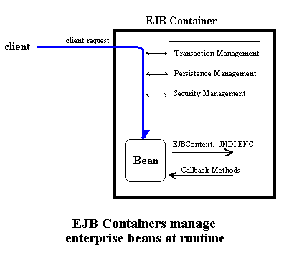
EJB Container(cont’d)

Slide 35
EJB Client
Finds EJBs via JNDI.
Invokes methods on EJBs.

Slide 36
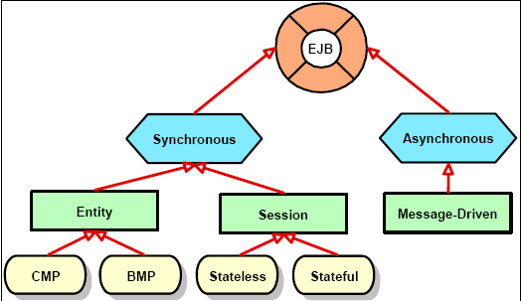
EJB components

Slide 37
EJB Interfaces -
Local and Remote
Local Interface
  Used for invoking EJBs within the same JVM (process)
  @Local annotation marks an interface local
  Parameters passed by reference
Remote Interface
  Used for invoking EJBs across JVMs (processes)
  @Remote annotation marks an interface remote
  Parameters passed by value (serialization/de- serialization)
Note: An EJB can implement both interfaces if needed.

Slide 38
Business Interface
Defines business methods
Session beans and message-driven beans require a business interface, optional for entity beans.
Business interface do not extend local or remote component interface (unlike EJB2.x)
Business Interfaces are POJIs (Plain Old Java Interfaces)

Slide 39
Business Interface - examples
Shopping cart that maintains state
public interface ShoppingStatefulCart {
void startShopping(String customerId);
void addProduct(String productId);
float getTotal();
}
Shopping cart that does not maintain state
public interface ShoppingStatelessCart {
String startShopping(String customerId); // return cartId
void addProduct(String cartId, String productId);
float getTotal(String cartId);
}

Slide 40
Stateless Session EJB (SLSB)
Does not maintain any conversational state with client
Instances are pooled to service multiple clients
@Stateless annotation marks a been stateless.
Lifecycle event callbacks supported for stateless session beans (optional)
  @PostConstruct occurs before the first business method invocation on the bean
  @PreDestroy occurs at the time the bean instance is destroyed

Slide 41
Stateless Session EJB example (1/2)
The business interface:
public interface HelloSessionEJB3Interface{
public String sayHello();
}

Slide 42
Stateless Session EJB example (2/2)
The stateless bean with local interface:
import javax.ejb.*;
import javax.annotation.*;
@Local({HelloSessionEJB3Interface.class})
@Stateless public class HelloSessionEJB3 implements HelloSessionEJB3Interface{
public String sayHello(){
return "Hello from Stateless bean“;
}
@PreDestroy void restInPeace() {
System.out.println(“I am about to die now“);
}
}

Slide 43
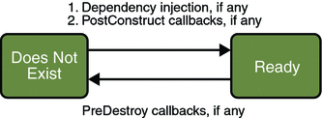
Lifecycle of a
Stateless Session Bean
A client initiates the life cycle by obtaining a reference
The container invokes the @PostConstruct method, if any
The bean is now ready to have its business methods invoked by clients
September 16, 2010
COMS W4156

Slide 44
Stateful Session EJB (SFSB)
Maintains conversational state with client
Each instance is bound to specific client session
Support callbacks for the lifecycle events listed on the next slide

Slide 45
Stateful Session EJB – example (1/2)
Define remote business interface (remote can be marked in bean class also) :
@Remote public interface ShoppingCart {
public void addItem(String item);
public void addItem(String item);
public Collection getItems();
}

Slide 46
Stateful Session EJB – example (2/2)
@Stateful public class CartBean implements ShoppingCart {
private ArrayList items;
@PostConstruct public void initArray() {
items = new ArrayList();
}
public void addItem(String item) {
items.add(item);
}
public void removeItem(String item) {
items.remove(item);
}
public Collection getItems() {
return items;
}
@Remove void logoff() {items=null;}
}

Slide 47
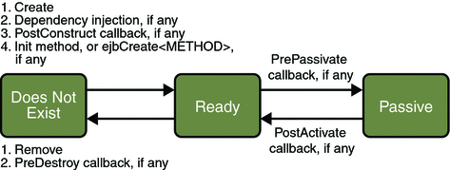
Lifecycle of a
Stateful Session Bean
Client initiates the lifecycle by obtaining a reference
Container invokes the @PostConstruct and @Init methods, if any
Now bean ready for client to invoke business methods
September 16, 2010
COMS W4156

Slide 48
Lifecycle of a
Stateful Session Bean
While in ready state, container may passivate and invoke the @PrePassivate method, if any
If a client then invokes a business method, the container invokes the @PostActivate method, if any, and it returns to ready stage
September 16, 2010
COMS W4156

Slide 49
Lifecycle of a
Stateful Session Bean
At the end of the life cycle, the client invokes a method annotated @Remove
The container calls the @PreDestroy method, if any
September 16, 2010
COMS W4156

Slide 50
Entity EJB (1)
It is permanent. Standard Java objects come into existence when they are created in a program. When the program terminates, the object is lost. But an entity bean stays around until it is deleted. In practice, entity beans need to be backed up by some kind of permanent storage, typically a database.
It is identified by a primary key. Entity Beans must have a primary key. The primary key is unique -- each entity bean is uniquely identified by its primary key. For example, an "employee" entity bean may have Social Security numbers as primary keys.
Note: Session beans do not have a primary key.

Slide 51
Entity Bean Class
@Entity annotation marks a class as Enity EJB
Persistent state of an entity bean is represented by non-public instance variables
For single-valued persistent properties, these method signatures are:
    <Type> getProperty()
    void setProperty(<Type> t)
Must be a non-final concrete class
Must have public or protected no-argument constructor
No methods of the entity bean class may be final
If entity bean must be passed by value (through a remote interface) it must implement Serializable interfa

Slide 52
Entity EJB
CMP (Container Managed Persistence)
  Container maintains persistence transparently using JDBC calls
BMP (Bean Managed Persistence)
  Programmer provides persistence logic
  Used to connect to non-JDBC data sources like LDAP, mainframe etc.
  Useful for executing stored procedures that return result sets

Slide 53
Entity EJB – example (1)
@Entity // mark as Entity Bean
public class Customer implements Serializable {
  private Long id;
  private String name;
  private Collection<Order> orders = new HashSet();
  @Id(generate=SEQUENCE) // primary key
  public Long getId() {
  return id;
  }
  public void setId(Long id) {
  this.id = id;
  }

Slide 54
Entity EJB – example (2)
  @OneToMany // relationship between Customer and Orders
  public Collection<Order> getOrders() {
  return orders;
  }
  public void setOrders(Collection<Order> orders) {
  this.orders = orders;
  }
}

Slide 55
EntityManager
EntityManager API is used to:
  create and remove persistent entity instances
  to find entities by their primary key identity, and to query over entities
EntityManager supports EJBQL and (non-portable) native SQL

Slide 56
Entity Bean Life Cycle
Entity bean instance has four possible states:
New entity bean instance has no persistent identity, and is not yet associated with a persistence context.
Managed entity bean instance is an instance with a persistent identity that is currently associated with a persistence context.
Detached entity bean instance is an instance with a persistent identity that is not (or no longer) associated with a persistence context.
Removed entity bean instance is an instance with a persistent identity, associated with a persistence context, scheduled for removal from the database.

Slide 57
Example of Use of EntityManager API
@Stateless public class OrderEntry {
@Inject EntityManager em;
public void enterOrder(int custID, Order newOrder) {
Customer cust = (Customer)em.find("Customer", custID);
cust.getOrders().add(newOrder);
newOrder.setCustomer(cust);
}
}

Slide 58
Message Driven EJB
Invoked by asynchronously by messages
Cannot be invoked with local or remote interfaces
@MessageDriven annotation with in class marks the Bean message driven
Stateless
Transaction aware

Slide 59
Message Driven EJB example
import javax.jms.Message;
import javax.jms.MessageListener;
import javax.ejb.MessageDriven;
@MessageDriven
public class MessageDrivenEJBBean implements MessageListener {
public void onMessage(Message message) {
if(message instanceof MyMessageType1)
doSomething(); // business method 1
if(message instanceof MyMessageType2)
doSomethingElse(); // business method 2
}
}

Slide 60
EJB Query Language (EJBQL)
EJBQL : RDBMS vendor independent query syntax
Query API supports both static queries (i.e., named queries) and dynamic queries.
Since EJB3.0, supports HAVING, GROUP BY, LEFT/RIGHT JOIN etc.

Slide 61
EJBQL - examples
Define named query:
@NamedQuery(
name="findAllCustomersWithName",
queryString="SELECT c FROM Customer c WHERE c.name LIKE :custName"
)
Use named query:
@Inject public EntityManager em;
//..
List customers = em.createNamedQuery("findAllCustomersWithName")
.setParameter("custName", "Smith")
.getResultList();

Slide 62
Deploying EJBs
EJB 3.0 annotations replace EJB 2.0 deployment descriptors in almost all cases
Values can be specified using annotations in the bean class itself
Deployment descriptor may be used to override the values from annotations

Slide 63
Some EJB Servers (Application Servers)
Company Product
IBM WebSphere
BEA Systems BEA WebLogic
Sun Microsystems Sun Application Server
Oracle Oracle Application Server
JBoss JBoss

Slide 64
Advantages of EJB
Simplifies the development of middleware components that are secure, transactional, scalable & portable.
Simplifies the process to focus mainly on business logic rather than application development.
Overall increase in developer productivity
Reduces the time to market for mission critical applications

Slide 65
Summary
Component based development focuses in grouping cohesive functions into reusable units called components
Components interact with other components and clients through interfaces
Distributed computing makes extensive use of component based development as it allows the different functionalities to be distributed over different systems.
Different component development technologies are there by different vendors (J2EE, .NET WCF services, etc.)

